Slide 1
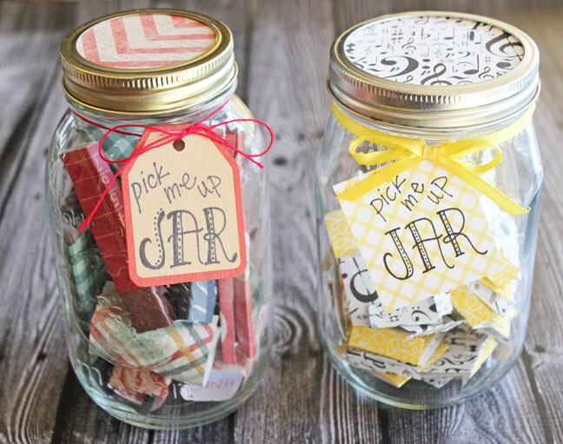
Pick me up jar
Find yourself an old jar from the kitchen. This could be an old jam jar/pasta sauce jar or something similar. Give it a clean out and start to decorate the front of it. You could use paper, stickers, ribbons etc whatever you can find! Make it as fancy as you like!
Once your jar is decorated you can use slips of paper to fill it full of all of your special qualities and talents! The purpose of the jar is to remind you of how special you are! Any time you are feeling down take a slip from the jar and be reminded of all the special qualities that make you YOU! 🥰

