Slide 1
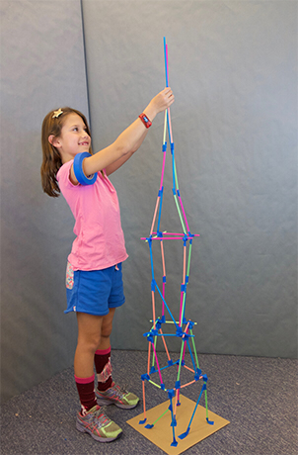
Straw tower challenge
Want more of a challenge?
Add a time limit or add family members and make it a group challenge!
Materials needed:
Straws
Paper clips
String
Pipe cleaners
Scissors
Challenge:
To create a tower using only the materials provided. The tower must be as tall as possible without falling over!

